Slide 1
Hackathon 3 “Sentiment Analysis”
By- Team Carpe Diem!
Sourabh Choudhary
Krishna Das
Sammek Ovhal
Aparna Singh

Slide 2
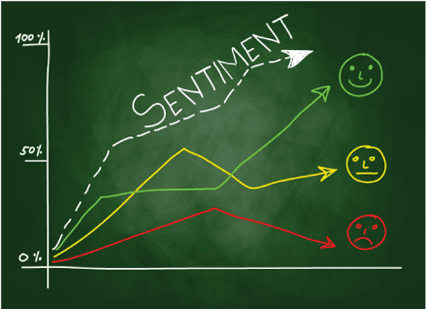
Business Problem @ WittyWicky Inc.
WittyWicky Inc. – Consulting firm who is a Brand strategist for product startups
Gain insights about sentiment associated with brand on social platform
Manual Assessment is time consuming, Automated process will be beneficial
As a Team of Data Scientist, we had to help to them analyze the sentiment associated with the brands and its competition

Slide 3
Eda and Pre-processing of Data
Exploration and Preprocessing to get familiar with the existing data
Data Cleaning-
Stopwords Removal
Tokenization
Manual Stopwords Addition
Lemmatization

Slide 4
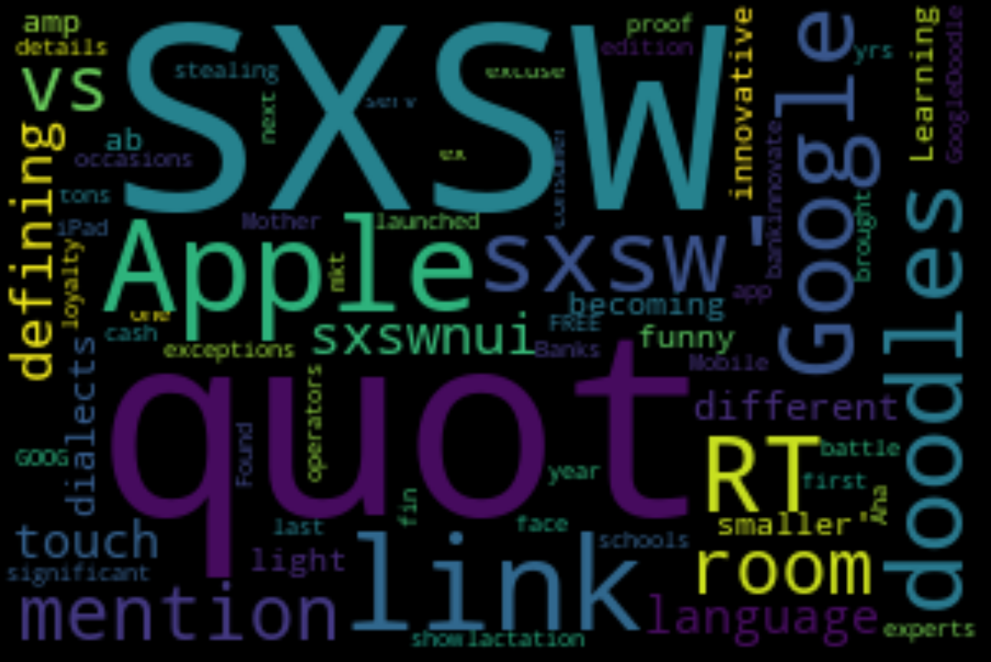
Wordcloud

Slide 5
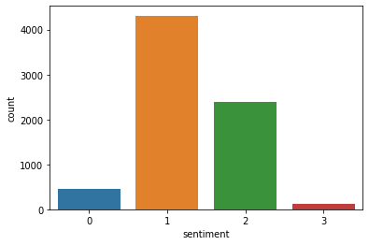
Distribution of Sentiments(Train)

Slide 6
Use of TF-IDF vectorizer
Term Frequency (TF)
Inverse Data Frequency (IDF)

Slide 7
Models used for The Analysis
1. Logistic Regression with TF-idf
2. Logistic Regression with Count-Vectorizer
3.BernoulliNB
4.MultinomialNB
5.Decision Tree Classifier
6.Random Forest Classifier

Slide 8
Model-Metrics
Model name | No. of Features | F1 Score
1. Logistic Regression with TF-idf |  | 0.62
2. Logistic Regression with Count-Vectorizer | Maximum features = 7000 Ngram = (1,1) Max iter = 300 | 0.67
3.BernoulliNB |  | 0.64
4.MultinomialNB |  | 0.65
5.Decision Tree Classifier |  | 0.62
6.Random Forest Classifier |  | 0.67

Slide 9
Final Model !!
Logistic Regression with Count-Vectorizer
( Maximum features = 7000
Ngram = (1,1)
Max iter = 300)
F1 Score=0.67

Slide 10
Insights
Data Integrity
Brand Awareness- On Social Media
Customer Feedback- For Enhancing better Services
Market Research For brand Competition
Market Awareness
ProActive-Crisis Management
ROI

Slide 11
Citations
https://www.kaggle.com/mohamedmosad/90-accuracy-of-sentiment-prediction
https://towardsdatascience.com/another-twitter-sentiment-analysis-with-python-part-5-50b4e87d9bdd
https://towardsdatascience.com/yet-another-twitter-sentiment-analysis-part-1-tackling-class-imbalance-4d7a7f717d44
https://www.kaggle.com/chirag19/twitter-sentiment-analysis
https://scikit-learn.org/stable/modules/generated/sklearn.linear_model.LogisticRegression.html
https://towardsdatascience.com/creating-the-twitter-sentiment-analysis-program-in-python-with-naive-bayes-classification-672e5589a7ed

Slide 12
Thankyou !!

